Slide 1


Team 48: Pocket Diagnostics
Bi-Weekly Update 4 Team members: Rohan Bharadwaj, Donavan Burrow, Jacob Newlin, Elijah Rodriguez Sponsor: Dr. John Lusher
TA: Zian Wang

Slide 2
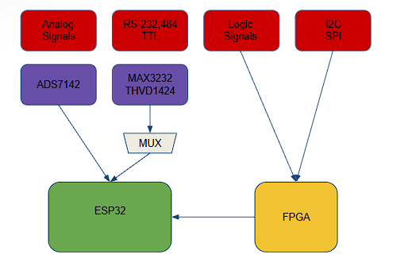
Project Summary
Problem statement:
Technicians in the electronics industry have evolved to servicing customers directly for consumer products, similarly to a plumber or electrician. Often they cannot bring or access bench devices and a suitable substitute is required to complete a job in a timely manner.
Function of the Pocket Diagnostics:
Provide a simple, man portable bench device that can evaluate low frequency electrical signals, I2C data signals, SPI data signals, Serial data signals and 16 channel logic signals for troubleshooting on devices that contain such data transfer methods.

Slide 3
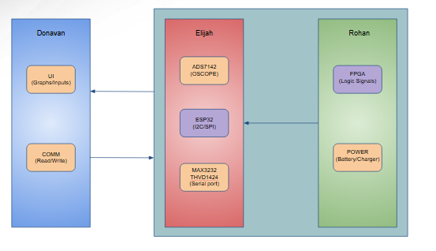
Integrated System Diagram

Slide 4
Project Timeline
Target or actual dates within or above boxes – green done, yellow underway, red deadline or function at risk, white not started
Subsystem Designs and Testing (to complete by 2/17 ) | Integration of Power and Data Processing subsystem with Data Acquisition and Communication Subsystem (to complete by 3/21) | Integration of App Development subsystem with Firmware subsystem. (to complete by 3/3) | Final Integration (to complete by 3/21) | System Test (to complete by 3/27) | Validation (to complete by 3/31) | Demo and Report (Prepared by 4/3)

Slide 5
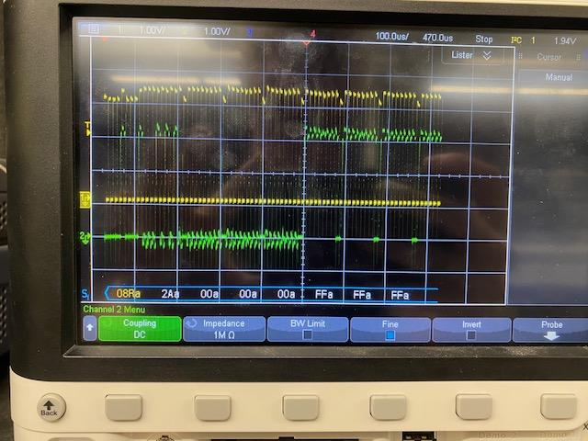
Firmware Design
Jacob Newlin
Accomplishments since last update 25 hrs of effort | Ongoing progress/problems and plans until the next presentation
Fixed I2C protocol Flashed code and Verified I2C for the ESP32 Tested all functions with the App | Integrate with FPGA board and begin testing edge cases for all designs

Slide 6
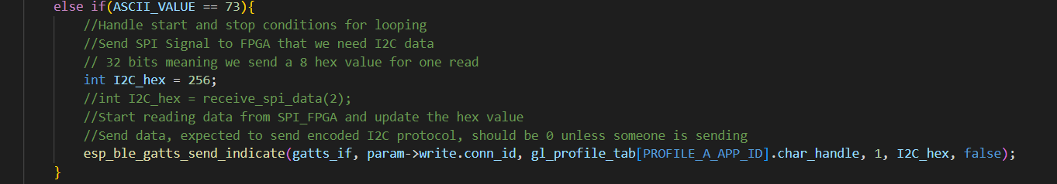
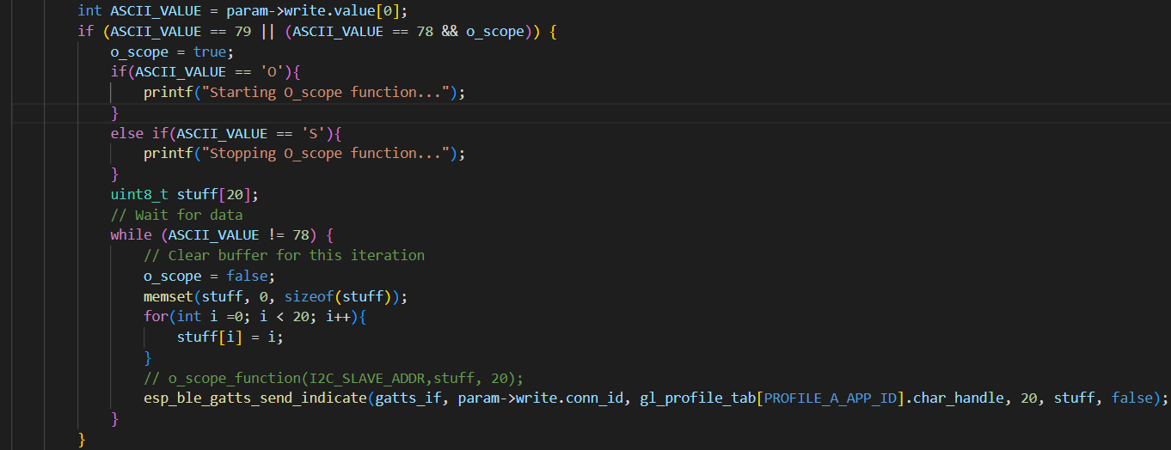
Firmware

Slide 7
Data Processing and Power
Rohan Bharadwaj
Accomplishments since last update 18 hrs of effort | Ongoing progress/problems and plans until the next presentation
Redesigned and reordered brand new PCB with corrected ADC converter. Have begun assembling the PCB. | Complete assembling PCB Integrate with remaining subsystems

Slide 8
Data Communication and Collection
Elijah Rodriguez
Accomplishments since last update 17 hrs of effort | Ongoing progress/problems and plans until the next presentation
Revised schematic and PCB design to implement TTL Integrated with Jacob Started Validation | Complete subsystem validation Integrate with Rohan (data processing and power)

Slide 9
App Design
Donavan Burrow
Accomplishments since last update 30 hrs of effort | Ongoing progress/problems and plans until the next presentation
Integration complete with Firmware UI changed | System Testing and Validation with Firmware

Slide 10
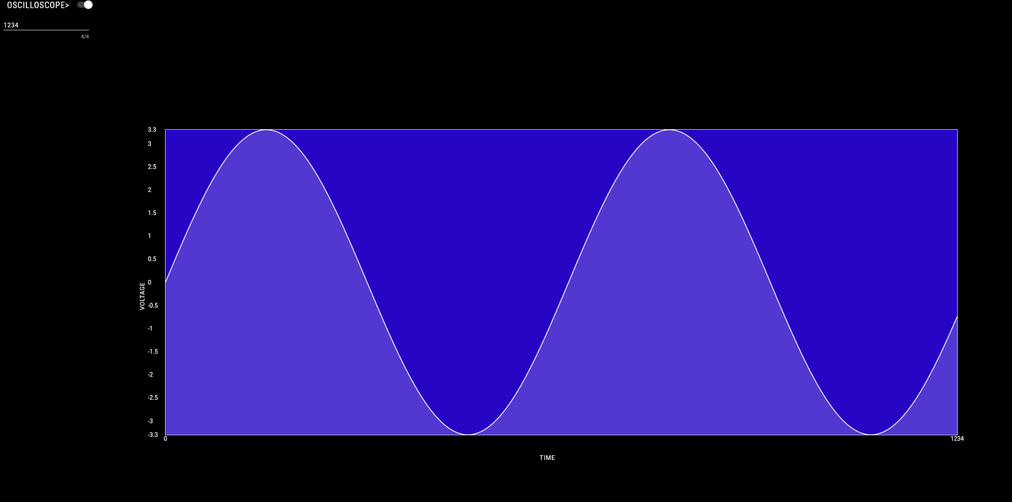
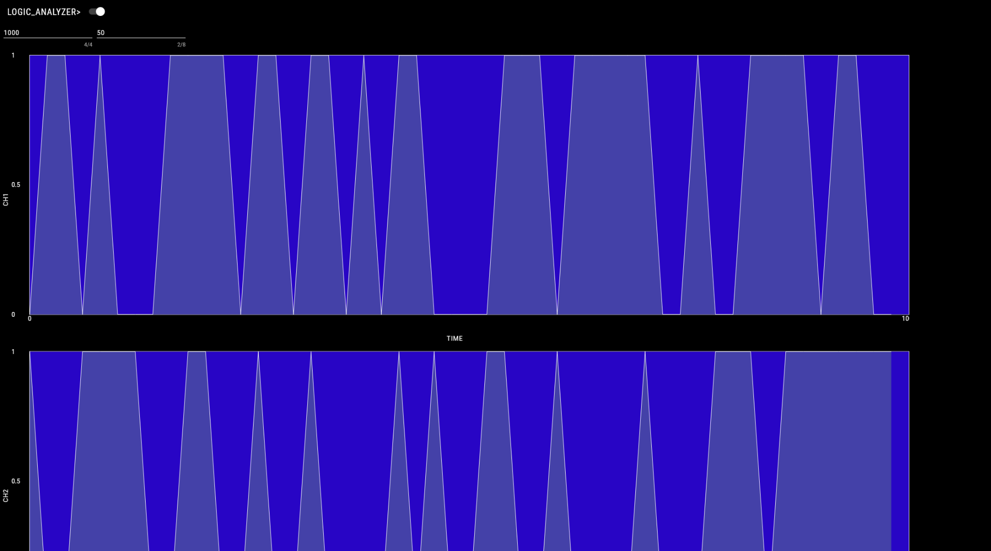
App Design cont.

Slide 11
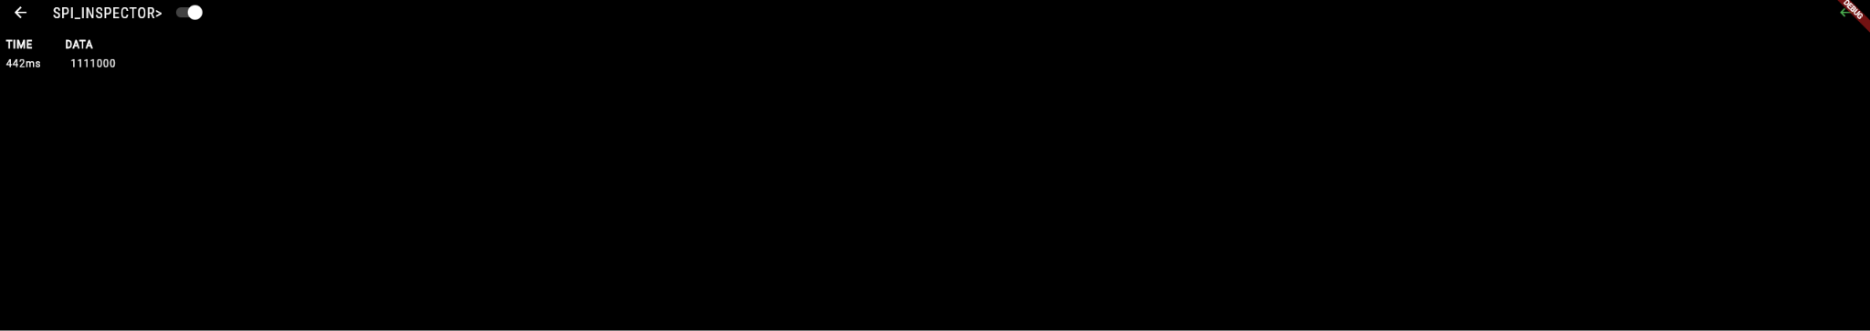
App Design cont.

Slide 12
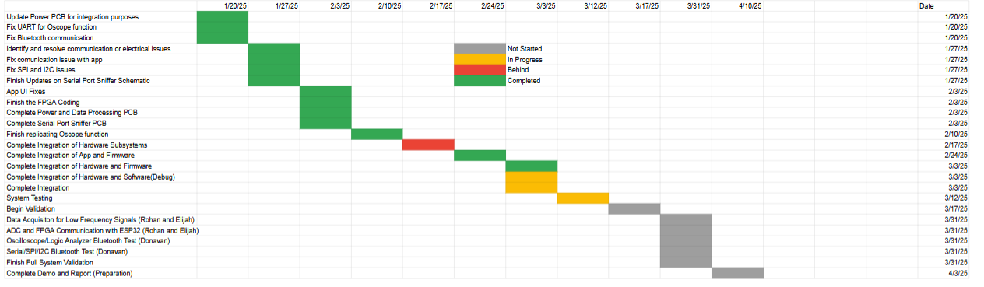
Execution Plan

Slide 13
Validation Plan
Paragraph # | Test Name | Success Criteria | Data | Status | Pass/Fail | Responsible Party
3.2.1.1 | Multi-Protocol Communication | Perform multi-protocol I. communication.1 MHz clock rate |  | UNTESTED |  | Rohan Bharadwaj, Elijah Rodriguez
3.2.1.2 | Data Acquisition for Low-Frequency Signals | Support data acquisition for low-frequency signals (up to 100 kHz) |  | UNTESTED |  | Rohan Bharadwaj, Elijah Rodriguez
3.2.1.3 | Logic Analysis | Capture and analyze signals with a sampling rate of up to 50 MS/s |  | UNTESTED |  | Rohan Bharadwaj
3.2.2.4 | Battery Life | 8 hours |  | UNTESTED |  | Rohan Bharadwaj
3.2.3.1.1 | Power Consumption | Maximum peak power should not exceed 4.5W |  | UNTESTED |  | Rohan Bharadwaj
3.2.3.1.2 | Input Voltage Level | 3.0-4.2V |  | TESTED | PASSED | Rohan Bharadwaj
4.3.1.1 | Power Distribution Validation | MAX3232 and THVD1451 receive 3.3V from ESP32 |  | TESTED | PASSED | Elijah Rodriguez
4.3.2.1 | MAX3232 and THVD1451 Level Shifting Verification | Voltage levels to 3.3V for the MAX3232 and THVD1451 |  | TESTED | PASSED | Elijah Rodriguez
4.3.3.1 | RealTerm Communication Validation | Ensure transmitted and received data match the RealTerm program |  | UNTESTED |  | Elijah Rodriguez
4.3.4.1 | Signal Integrity Validation | Stable signal waveforms for RS protocols |  | UNTESTED |  | Elijah Rodriguez

Slide 14
Validation Plan
Paragraph # | Test Name | Success Criteria | Data | Status | Pass/Fail | Responsible Party
5.2.1 | Bluetooth Connection Event | Connection event displayed on app for phone and ESP32 | “Device Connected” displayed in terminal | TESTED | PASS | Donavan Burrow, Jacob Newlin
5.2.2 | Bluetooth Read | “Received Data” List with all data displayed | ‘Received Data: […]’ | TESTED | PASS | Donavan Burrow, Jacob Newlin
5.2.2 | Bluetooth Write | Terminal Displays all data transactions | ‘utf8(“Data type”), Time, Time’ | TESTED | PASS | Donavan Burrow, Jacob Newlin
5.2.3 | Data Display | Phone displays correct data on graph for each data type |  | UNTESTED |  | Donavan Burrow

Slide 15
Thank You!

